Slide 1
INTERPROCESS COMMUNICATION

Slide 2
fork() in C
Fork system call is used for creating a new process, called child process, which runs concurrently with the parent process.
After a new child process is created, both processes will execute the next instruction following the fork() system call.
A child process uses the same PC , same CPU registers, same open files use in the parent process.

Slide 3
It takes no parameters and returns an integer value. Below are different values returned by fork().
Negative Value: creation of a child process was unsuccessful.
Zero: Returned to the newly created child process.
Positive value: Returned to parent or caller.
The value contains process ID of newly created child process.

Slide 4
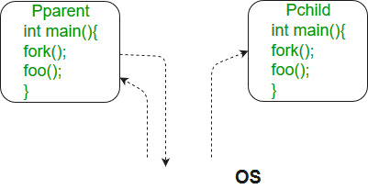
fork() in C

Slide 5
Predict The Output Of following Program
#include <stdio.h>
#include <sys/types.h>
#include <unistd.h>
int main()
{ // make 2 process that run same prg after this instruction
fork();
printf("Hello world!\n");
return 0;
}

Slide 6
Output:
Hello world!
Hello world!

Slide 7
#include <stdio.h>
#include <sys/types.h>
int main()
{
fork();
fork();
fork();
printf("hello\n");
return 0;
}

Slide 8
Output:
hello
hello
hello
hello
hello
hello
hello
Hello
Number of times hello printed is equal to number of process created.
Total Number of Processes = 2^n where n is number of fork system calls.
So here n = 3, 2^3 = 8

Slide 9
fork (); // Line 1
fork (); // Line 2
fork (); // Line 3
L1 // There will be 1 child process
/ \ // created by line 1.
L2 L2 // There will be 2 child processes
/ \ / \ // created by line 2
L3 L3 L3 L3 // There will be 4 child processes
// created by line 3

Slide 10
So there are total eight processes (new child processes and one original process).
If we want to represent the relationship between the processes as a tree hyerarchy it would be the following:
The main process: P0
Processes created by the 1st fork: P1
Processes created by the 2nd fork: P2, P3
Processes created by the 3rd fork: P4, P5, P6, P7

Slide 11
P0
/ | \
P1 P4 P2
/ \ \
P3 P6 P5
/
P7

Slide 12
#include <stdio.h>
#include <sys/types.h>
#include <unistd.h>
void forkexample()
{
if (fork() == 0) // child process because return value zero
printf("Hello from Child!\n");
else
printf("Hello from Parent!\n"); }
int main()
{ forkexample();
return 0; }

Slide 13
Two possible outputs
System Dependent
1.
Hello from Child!
Hello from Parent!
(or)
2.
Hello from Parent!
Hello from Child!

Slide 14
Here, two outputs are possible because the parent process and child process are running concurrently.
So we don’t know if OS first give control to which process a parent process or a child process.
Important: Parent and child process are running the same program, but they are not identical.
OS allocate different data and state for these two processes and also control the flow of these processes can be different.

Slide 15
#include <stdio.h>
#include <sys/types.h>
#include <unistd.h>
void forkexample()
{
int x = 1;
if (fork() == 0) printf("Child has x = %d\n", ++x);
else printf("Parent has x = %d\n", --x);
}
int main()
{
forkexample(); return 0; }

Slide 16
OUTPUT
Parent has x = 0
Child has x = 2
(or)
Child has x = 2
Parent has x = 0
Here, global variable change in one process does not affected two other processes because data/state of two processes are different.
And also parent and child run simultaneously so two outputs are possible.

Slide 17
fork() vs exec()
The fork system call creates a new process.
The new process created by fork() is copy of the current process except the returned value.
The exec() system call replaces the current process with a new program.

Slide 18
What will be the output of following program?
A process executes the following code.
for (i = 0; i < n; i++)
fork();
The total number of child processes created is:
(A) n
(B) 2^n – 1
(C) 2^n
(D) 2^(n+1) – 1;

Slide 19
F0 // 1 child process created by first fork
/ \
F1 F1 // 2 child processes by second fork
/ \ / \
F2 F2 F2 F2 // 4 child created by third fork
/ \ / \ / \ / \
............... // and so on
If we sum all levels of above tree for i = 0 to n-1, we get
2^n - 1. So there will be 2^n - 1 child processes.
On the other hand, the total number of process created are (number of child processes)+1.
ANSWER B

Slide 20
Consider the following code fragment:
if (fork() == 0) {
a = a + 5;
printf("%d, %d\n", a, &a);
}
else {
a = a –5;
printf("%d, %d\n", a, &a);
}

Slide 21
Let u, v be the values printed by the parent process, and x, y be the values printed by the child process. Which one of the following is TRUE?
(A) u = x + 10 and v = y
(B) u = x + 10 and v != y
(C) u + 10 = x and v = y
(D) u + 10 = x and v != y

Slide 22
Answer: (C)
Explanation: fork() returns 0 in child process and process ID of child process in parent process.
In Child (x), a = a + 5
In Parent (u), a = a – 5;
Therefore x = u + 10.
Physical addresses of ‘a’ in parent and child must be different. As this program accesses virtual addresses. The child process gets an exact copy of parent process and virtual address of ‘a’ doesn’t change in child process.

Slide 23
#include <stdio.h>
#include <unistd.h>
int main()
{
fork();
fork() && fork() || fork();
fork();
printf("forked\n");
return 0;
}

Slide 24
A fork() system call spawn processes as leaves of growing binary tree.
If we call fork() twice, it will spawn 2*2 = 4 processes.
All these 4 processes forms the leaf children of binary tree.
In general if we are level l, and fork() called unconditionally, we will have 2l processes at level (l+1).
It is equivalent to number of maximum child nodes in a binary tree at level (l+1).

Slide 25
Wait System Call in C
A call to wait() blocks the calling process until one of its child processes exits or a signal is received.
After child process terminates, parent continues its execution after wait system call instruction.
Child process may terminate due to any of these:
It calls exit();
It returns (an int) from main
It receives a signal (from the OS or another process) whose default action is to terminate.

Slide 26
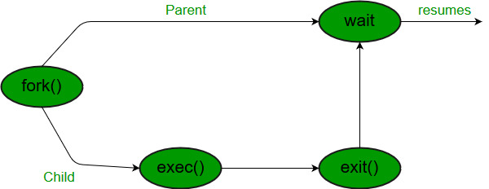

Slide 27
#include
#include
// take one argument status and returns
// a process ID of dead children.
pid_t wait(int *stat_loc);

Slide 28
If any process has more than one child processes, then after calling wait(), parent process has to be in wait state if no child terminates.
If only one child process is terminated, then return a wait() returns process ID of the terminated child process.
If more than one child processes are terminated than wait() reap any arbitrarily child and return a process ID of that child process.

Slide 29
When wait() returns they also define exit status (which tells our, a process why terminated) via pointer, If status are not NULL.
If any process has no child process then wait() returns immediately “-1”.

Slide 30
// C program to demonstrate working of wait()
#include<stdio.h>
#include<stdlib.h>
#include<sys/wait.h>
#include<unistd.h>
int main() {
pid_t cpid;
if (fork()== 0) exit(0); /* terminate child */
else
cpid = wait(NULL); /* reaping parent */
printf("Parent pid = %d\n", getpid());
printf("Child pid = %d\n", cpid); return 0; }

Slide 31
Output:
Parent pid = 12345678
Child pid = 89546848

Slide 32
#include<stdio.h>
#include<sys/wait.h>
#include<unistd.h>
int main() {
if (fork()== 0)
printf("HC: hello from child\n");
else {
printf("HP: hello from parent\n");
wait(NULL);
printf("CT: child has terminated\n"); }
printf("Bye\n");
return 0;
}

Slide 33
Output: depend on environment
HC: hello from child
Bye
HP: hello from parent
CT: child has terminated
(or)
HP: hello from parent
HC: hello from child
CT: child has terminated // this sentence does
// not print before HC
// because of wait.
Bye

Slide 34
Child status information:
Status information about the child reported by wait is more than just the exit status of the child, it also includes
normal/abnormal termination
termination cause
exit status
/*if we want to print information about a signal */
void psignal(unsigned sig, const char *s);
To find information about status, we use WIF….macros

Slide 35
1. WIFEXITED(status): child exited normally
• WEXITSTATUS(status): return code when child exits
2. WIFSIGNALED(status): child exited because a signal was not caught
• WTERMSIG(status): gives the number of the terminating signal
3. WIFSTOPPED(status): child is stopped
• WSTOPSIG(status): gives the number of the stop signal

Slide 36
// C program to demonstrate working of status from wait.
#include<stdio.h>
#include<stdlib.h>
#include<sys/wait.h>
#include<unistd.h>
void waitexample()
{
int stat;
// This status 1 is reported by WEXITSTATUS
if (fork() == 0)
exit(1);

Slide 37
else
wait(&stat);
if (WIFEXITED(stat))
printf("Exit status: %d\n", WEXITSTATUS(stat));
else if (WIFSIGNALED(stat))
psignal(WTERMSIG(stat), "Exit signal");
}
// Driver code
int main()
{
waitexample();
return 0; }

Slide 38
OUTPUT
Exit status: 1
We know if more than one child processes are terminated, then wait() reaps any arbitrarily child process but if we want to reap any specific child process, we use waitpid() function.

Slide 39
pid_t waitpid (child_pid, &status, options);
If value of Options is 0 means no option parent has to wait for terminates child.
WNOHANG means parent does not wait if child does not terminate just check and return waitpid().
child_pid is -1 then means any arbitrarily child, here waitpid() work same as wait() work.
Return value of waitpid()
pid of child, if child has exited
0, if using WNOHANG and child hasn’t exited

Slide 40
// C program to demonstrate waitpid()
#include<stdio.h>
#include<stdlib.h>
#include<sys/wait.h>
#include<unistd.h>
void waitexample()
{
int i, stat;
pid_t pid[5];
for (i=0; i<5; i++)
{

Slide 41
if ((pid[i] = fork()) == 0)
{
sleep(1);
exit(100 + i); } }
// Using waitpid() and printing exit status of children.
for (i=0; i<5; i++)
{
pid_t cpid = waitpid(pid[i], &stat, 0);
if (WIFEXITED(stat))
printf("Child %d terminated with status: %d\n",
cpid, WEXITSTATUS(stat));
} }

Slide 42
// Driver code
int main()
{
waitexample();
return 0;
}

Slide 43
Output:
Child 50 terminated with status: 100
Child 51 terminated with status: 101
Child 52 terminated with status: 102
Child 53 terminated with status: 103
Child 54 terminated with status: 104
Here, Children pids depend on the system but in order print all child information.

Slide 44
Signals in C language
How the OS communicate to an application process?
How an application process communicate to the OS?
Exactly what happens when you:
Type Ctrl-c?
Keyboard sends hardware interrupt
Hardware interrupt is handled by OS
OS sends a 2/SIGINT signal

Slide 45
Type Ctrl-z?
Keyboard sends hardware interrupt
Hardware interrupt is handled by OS
OS sends a 20/SIGTSTP signal
Issue a “kill –sig pid” command?
  OS sends a sig signal to the process whose id is pid
Issue a “fg” or “bg” command?
  OS sends a 18/SIGCONT signal (and does some other things too!)

Slide 46
Signals in C language
A signal is a software generated interrupt that is sent to a process by the OS because of when user press ctrl-c or another process tell something to this process.
Signal: A notification of an event
Event gains attention of the OS
OS stops the process immediately, sending it a signal
Signal handler executes to completion
Application process resumes where it left off

Slide 47
Process
movl
pushl
call f
addl
movl
.
.
.
void handler(int iSig)
{
…
}
signal

Slide 48
Sending Signals via Keystrokes
Three signals can be sent from keyboard:
  Ctrl-c → 2/SIGINT signal
    Default handler exits process
  Ctrl-z → 20/SIGTSTP signal
    Default handler suspends process
  Ctrl-\ → 3/SIGQUIT signal
    Default handler exits process

Slide 49
Sending Signals via Commands
kill Command
  kill -signal pid
    Send a signal of type signal to the process with id pid
    Can specify either signal type name (-SIGINT) or number (-2)
  No signal type name or number specified => sends 15/SIGTERM signal
    Default 15/SIGTERM handler exits process
  Editorial comment: Better command name would be sendsig
Examples
  kill –2 1234
  kill -SIGINT 1234
  Same as pressing Ctrl-c if process 1234 is running in foreground

Slide 50
UNIX Process Control
Non-Existing
Process
↓ command
↑ Ctrl-c
↓ command &
↑ kill –2 pid
Running
Foreground
Process
← fg
Running
Background
Process
↑ kill –2 pid
↓ Ctrl-z
↑ fg
↓ kill -20 pid
↑ bg
Stopped
Background
Process

Slide 51
There are fix set of signals that can be sent to a process. signals are identified by integers.
Signal number have symbolic names.
For example SIGCHLD is number of the signal sent to the parent process when child terminates.
#define SIGHUP 1 /* Hangup the process */
#define SIGINT 2 /* Interrupt the process */
#define SIGQUIT 3 /* Quit the process */
#define SIGILL 4 /* Illegal instruction. */
#define SIGTRAP 5 /* Trace trap. */
#define SIGABRT 6 /* Abort. */

Slide 53
OS Structures for Signals
For each process, the OS maintains 2 integers with the bits corresponding to a signal numbers.
The two integers keep track of: pending signals and blocked signals
With 32 bit integers, up to 32 different signals can be represented.

Slide 54
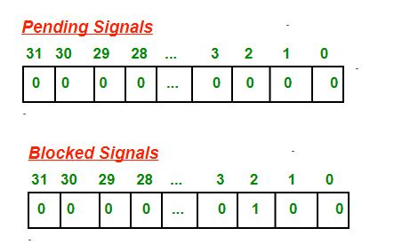
Example : In the example below, the SIGINT ( = 2) signal is blocked and no signals are pending.

Slide 55
A signal is sent to a process setting the corresponding bit in the pending signals integer for the process.
Each time the OS selects a process to be run , the pending and blocked integers are checked.
If no signals are pending, the process is restarted normally and continues executing its next instruction.
If 1 or more signals are pending, but each one is blocked, the process is also restarted normally but with the signals still marked as pending.
If 1 or more signals are pending and NOT blocked, the OS executes the routines in the process’s code to handle the signals.

Slide 56
Default Signal Handlers
There are several default signal handler routines.
Each signal is associated with one of these default handler routine.
The different default handler routines typically have one of the following actions:
Ign: Ignore the signal; i.e., do nothing, just return
Term: terminate the process
Cont: unblock a stopped process
Stop: block the process

Slide 57
// C program to illustrate default Signal Handler
#include<stdio.h>
#include<signal.h>
int main() {
signal(SIGINT, handle_sigint);
while (1) {
printf(“hello world\n”);
sleep(1);
} return 0;
}

Slide 58
Output:
Print hello world infinite times.
If user presses ctrl-c to terminate the process because of SIGINT signal sent and its default handler to terminate the process.
hello world
hello world
hello world
terminated

Slide 59
User Defined Signal Handlers
A process can replace the default signal handler for almost all signals (but not SIGKILL) by its user’s own handler function.
A signal handler function can have any name, but must have return type void and have one int parameter.
Example: you might choose the name sigchld_handler for a signal handler for the SIGCHLD signal (termination of a child process).

Slide 60
Then the declaration would be:
void sigchld_handler(int sig);
When a signal handler executes, the parameter passed to it is the number of the signal.
A programmer can use the same signal handler function to handle one or several signals.
In several signals case the handler would need to check the parameter to see which signal was sent.

Slide 61
// C program to show User-defined Signal Handler
#include<stdio.h>
#include<signal.h>
// Handler for SIGINT, caused by Ctrl-C at keyboard
void handle_sigint(int sig)
{
printf("Caught signal %d\n", sig); }
int main()
{ signal(SIGINT, handle_sigint);
while (1) ;
return 0; }

Slide 62
Output:
^CCaught signal 2 // when user presses ctrl-c
^CCaught signal 2

Slide 63
We can send a signal using kill() to the process.
int kill(pid_t pid, int signal);
pid: id of destination process
signal: the type of signal to send
Return value: 0 if signal was sent successfully
Example:
pid_t iPid = getpid(); /* Process gets its id.*/
kill(iPid, SIGINT); /* Process sends itself a SIGINT signal (commits suicide?)(because of SIGINT
signal default handler is terminate the process) */

Slide 64
WHAT will be the output of following programs
#include<stdio.h>
#include<wait.h>
#include<signal.h>
int main()
{
int stat;
pid_t pid;
if ((pid = fork()) == 0)
while(1) ;

Slide 65
else
{
kill(pid, SIGINT);
wait(&stat);
if (WIFSIGNALED(stat))
psignal(WTERMSIG(stat), "Child term due to");
}
}

Slide 66
Output:
Child term due to: Interrupt

Slide 67
#include<stdio.h>
#include<signal.h>
#include<wait.h>
int val = 10;
void handler(int sig)
{
val += 5;
}

Slide 68
int main()
{
pid_t pid;
signal(SIGCHLD, handler);
if ((pid = fork()) == 0)
{ val -= 3;
exit(0); }
waitpid(pid, NULL, 0);
printf("val = %d\n", val);
exit(0); }

Slide 69
Output:
val = 15

Slide 70
Consider the following code. What is the output?
#include<stdio.h>
#include<wait.h>
#include<signal.h>
pid_t pid;
int counter = 0;
void handler1(int sig)
{
counter++;
printf("counter = %d\n", counter);
/* Flushes the printed string to stdout */

Slide 71
fflush(stdout);
kill(pid, SIGUSR1);
}
void handler2(int sig)
{
counter += 3;
printf("counter = %d\n", counter);
exit(0);
}

Slide 72
int main()
{
pid_t p; int status;
signal(SIGUSR1, handler1);
if ((pid = fork()) == 0) {
signal(SIGUSR1, handler2);
kill(getppid(), SIGUSR1);
while(1) ; }
if ((p = wait(&status)) > 0) {
counter += 4;
printf("counter = %d\n", counter); } }

Slide 73
Output
counter = 1 //(parent’s handler)
counter = 3 //(child’s handler)
counter = 5 //(parent’s main)

Slide 74
Communication between two process (child and parent )using signals in C
It is done using kill() and signal(), fork() .
fork() creates the child process from the parent.
The pid can be checked to decide whether it is child (pid == 0) or parent (pid = child process id).
The parent can then send messages to child using the pid and kill().
The child picks up these signals with signal() and calls appropriate functions.

Slide 75
// C program to implement sighup(), sigint()
// and sigquit() signal functions
#include <signal.h>
#include <stdio.h>
#include <stdlib.h>
#include <sys/types.h>
#include <unistd.h>
void sighup();
void sigint();
void sigquit();

Slide 76
void main() // driver code
{ int pid;
/* get child process */
if ((pid = fork()) < 0) {
perror("fork");
exit(1); }
if (pid == 0) { /* child */
signal(SIGHUP, sighup);
signal(SIGINT, sigint);
signal(SIGQUIT, sigquit);
for (;;) ; /* loop for ever */ }

Slide 77
else /* parent */
{ /* pid hold id of child */
printf("\nPARENT: sending SIGHUP\n\n");
kill(pid, SIGHUP);
sleep(3); /* pause for 3 secs */
printf("\nPARENT: sending SIGINT\n\n");
kill(pid, SIGINT);
sleep(3); /* pause for 3 secs */
printf("\nPARENT: sending SIGQUIT\n\n");
kill(pid, SIGQUIT);
sleep(3); } }

Slide 78
void sighup()
{ signal(SIGHUP, sighup); /* reset signal */
printf("CHILD: I have received a SIGHUP\n"); }
void sigint()
{
signal(SIGINT, sigint); /* reset signal */
printf("CHILD: I have received a SIGINT\n"); }
void sigquit()
{
printf("My DADDY has Killed me!!!\n");
exit(0); }

Slide 79
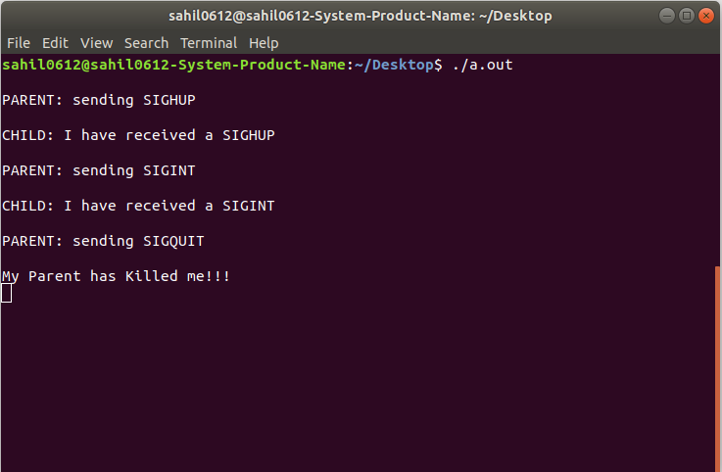

Slide 80
Inter Process Communication (IPC)
A process can be of two type:
Independent process.
Co-operating process.
An independent process is not affected by the execution of other processes while a co-operating process can be affected by other executing processes.
Though one can think that those processes, which are running independently, will execute very efficiently

Slide 81
but in practical, there are many situations when co-operative nature can be utilised for increasing computational speed, convenience and modularity.
Inter process communication (IPC) is a mechanism which allows processes to communicate each other and synchronize their actions.
The communication between these processes can be seen as a method of co-operation between them.

Slide 82
Processes can communicate with each other using these two ways:
Shared Memory
Message passing
The Figure below shows a basic structure of communication between processes via shared memory method and via message passing.

Slide 83
An OS can implement both method of communication.
Communication between processes using shared memory requires processes to share some variable and it completely depends on how programmer will implement it.
Processes can use shared memory for extracting information as a record from other process as well as for delivering any specific information to other process.

Slide 84
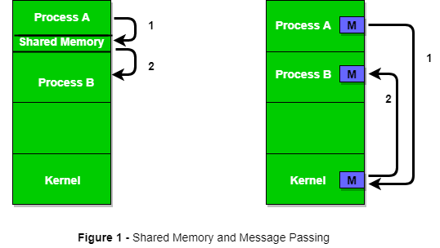
Inter Process Communication (IPC)

Slide 85
Ex: Producer-Consumer problem
There are two processes: Producer and Consumer. Producer produces some item and Consumer consumes that item.
The two processes shares a common space or memory location known as buffer where the item produced by Producer is stored and from where the Consumer consumes the item if needed.

Slide 86
Ex: Producer-Consumer problem
There are two version of this problem: first one is known as unbounded buffer problem in which Producer can keep on producing items and there is no limit on size of buffer, the second one is known as bounded buffer problem in which producer can produce up to a certain amount of item and after that it starts waiting for consumer to consume it.

Slide 87
The bounded buffer problem.
First, the Producer and the Consumer will share some common memory, then producer will start producing items. If the total produced item is equal to the size of buffer, producer will wait to get it consumed by the Consumer. Similarly, the consumer first check for the availability of the item and if no item is available, Consumer will wait for producer to produce it. If there are items available, consumer will consume it.

Slide 88
# define buff_max 25
# define mod %
struct item{
// diffrent member of the produced data
// or consumed data
---------
}
// An array is needed for holding the items. This is the shared place

Slide 89
// item shared_buff [ buff_max ];
// Two variables which will keep track of the indexes of the items produced
// The free index points to the next free index.
// The full index points to the first full index.
int free_index = 0;
int full_index = 0;

Slide 90
Producer Process Code
item nextProduced;
while(1){
// check if there is no space for production.
// if so keep waiting.
while((free_index+1) mod buff_max == full_index);
shared_buff[free_index] = nextProduced;
free_index = (free_index + 1) mod buff_max;
}

Slide 91
Consumer Process Code
item nextConsumed;
while(1){
// check if there is an available item for consumption. // if not keep on waiting for get them produced.
while((free_index == full_index);
nextConsumed = shared_buff[full_index];
full_index = (full_index + 1) mod buff_max;
}

Slide 92
In the above code, The producer will start producing again when the (free_index+1) mod buff max will be free because if it it not free, this implies that there are still items that can be consumed by the Consumer so there is no need to produce more.
Similarly, if free index and full index points to the same index, this implies that there are no item to consume.

Slide 93
Messaging Passing Method
processes communicate without using shared memory.
If two processes p1 and p2 want to communicate with each other, they proceed as follow:
Establish a communication link
Start exchanging messages using basic primitives.
We need at least two primitives:
– send(message, destinaion) or send(message)
– receive(message, host) or receive(message)

Slide 94
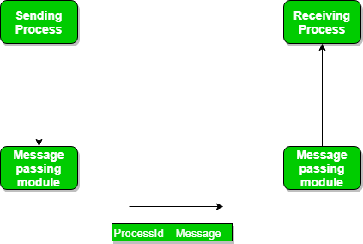
Messaging Passing Method

Slide 95
The message size can be of fixed size or of variable size.
If it is of fixed size, it is easy for OS designer but complicated for programmer and if it is of variable size then it is easy for programmer but complicated for the OS designer.
A standard message can have two parts: header and body.

Slide 96
The header part is used for storing Message type, destination id, source id, message length and control information.
The control information contains information like what to do if runs out of buffer space, sequence number, priority.
Generally, message is sent using FIFO style.

